Slide 1
YOLO v1/v2/v3
Real-time object detector

Slide 2
Outline
Detection systems 2016
YOLO v1
YOLO v2
YOLO v3

Slide 3
Detection systems in 2016
Deformable Parts Models (DPM)
Uses a sliding window approach, classifies at each window location
“Brute force method”
Slow
R-CNN
Generates potential bounding boxes, then CNN to compute feature vectors, then feature vectors are fed into a SVM classifier(s), then post-processing…
Complex pipeline, each image takes multiple seconds to classify

Slide 4
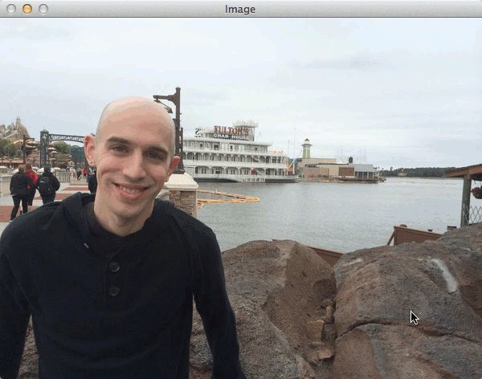
Sliding window approach

Slide 5
Why YOLO?
Detection systems in 2016:
Deformable Parts Models (DPM)
Uses a sliding window approach and classifies at each step
“Brute force method” => inefficient
Doesn’t retain contextual information
R-CNN
Generates potential bounding boxes, then CNN to compute feature vectors, then feature vectors are fed into a SVM classifier(s), then post-processing...
Complex pipeline, each image takes multiple seconds to classify each image

Slide 6
YOLO v1
You Only Look Once
Adresses DPM and R-CNN’s shortcomings
Much faster
25 ms latency
Encodes contextual information about classes
Fewer misclassifications where background are treated as objects
Also, it generalizes better
Trained on natural images, yet it detects well on artwork

Slide 7
YOLO v1 - How does it work?
“A single convolutional network simultaneously predicts multiple bounding boxes and class probabilities for those boxes”
…
“Trained on a loss function that directly corresponds to detection performance and the entire model is trained jointly.“

Slide 8
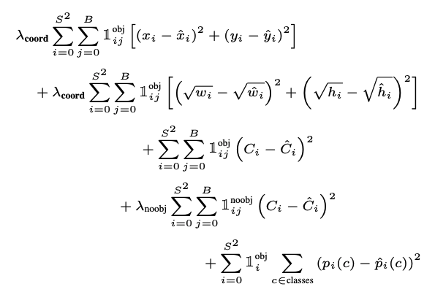
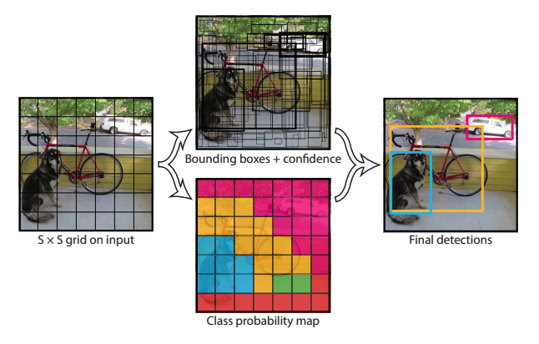
Reframing object detection into a loss function
=>

Slide 9
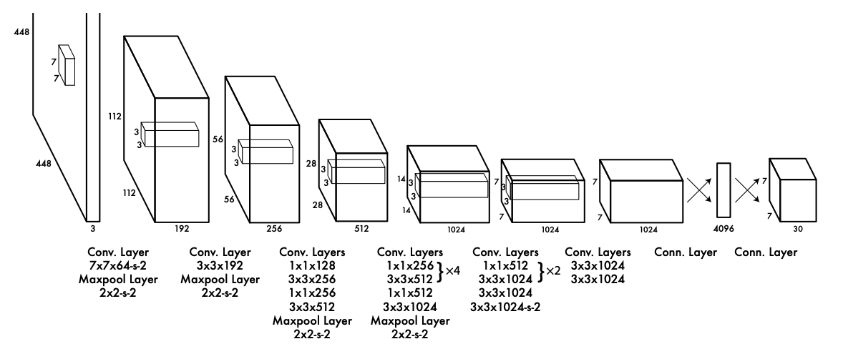
YOLO v1 - Architecture
Inspired by GoogLeNet
23 convolutional layers followed by 2 fully connected layers

Slide 10
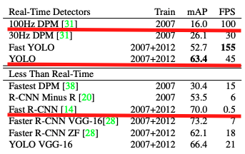
Results - Pascal VOC 2007
Fast, yet fairly good accuracy

Slide 11
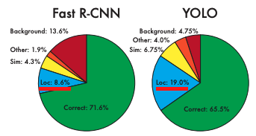
Results - Pascal VOC 2007
Struggles with localization
… and with small objects that appears in groups

Slide 12
YOLO v2
Addresses YOLO v1 issues
Better
Faster
Stronger

Slide 13
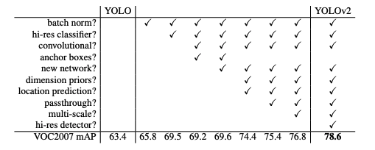
YOLO v2 - Better
Implements a lot of techniques to increase the mean average precision
E.g. adding passthrough layer so the model can use fine grained features
The model detects smaller objects better

Slide 14
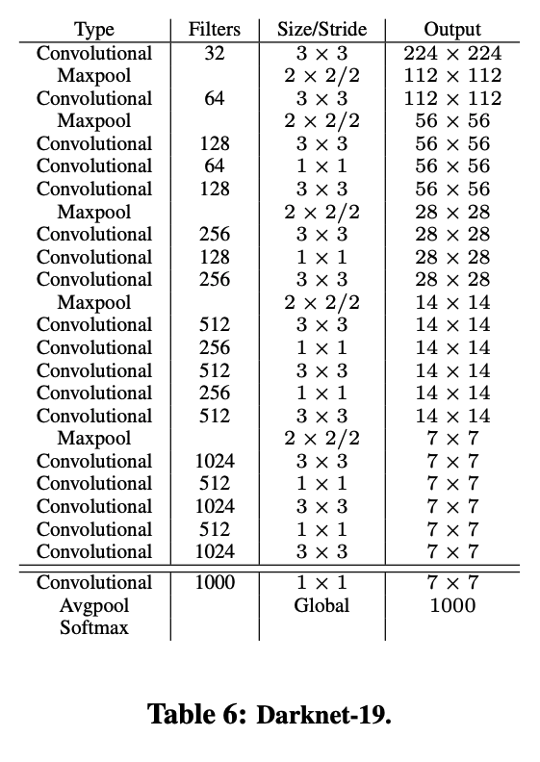
YOLO v2 - Faster
New architecture
Darknet-19
Reduces the amount of operations needed for a forward pass
YOLO v1 - 8.52 billion operations - 88% accuracy
YOLO v2 - 5.82 billion operations - 91.2% accuracy

Slide 15
YOLO v2 - Stronger
YOLO v1 could not classify many different objects
Trained on Pascal VOC, only 20 classes
Object detection datasets are limited
Object detection: Thousands to hundreds of thousands of images, few classes
Classification: Millions of images, tens or hundred of thousands classes
YOLO v2
Combines COCO (detection) and ImageNet (classification)
Can classify more than 9000 classes

Slide 16
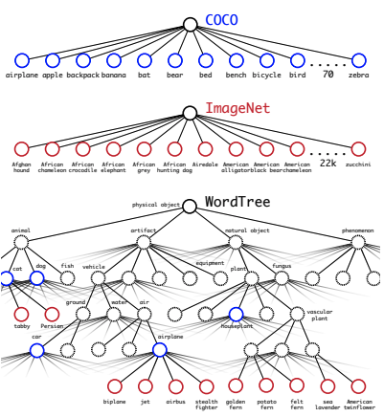
YOLO v2 - Combined dataset

Slide 17
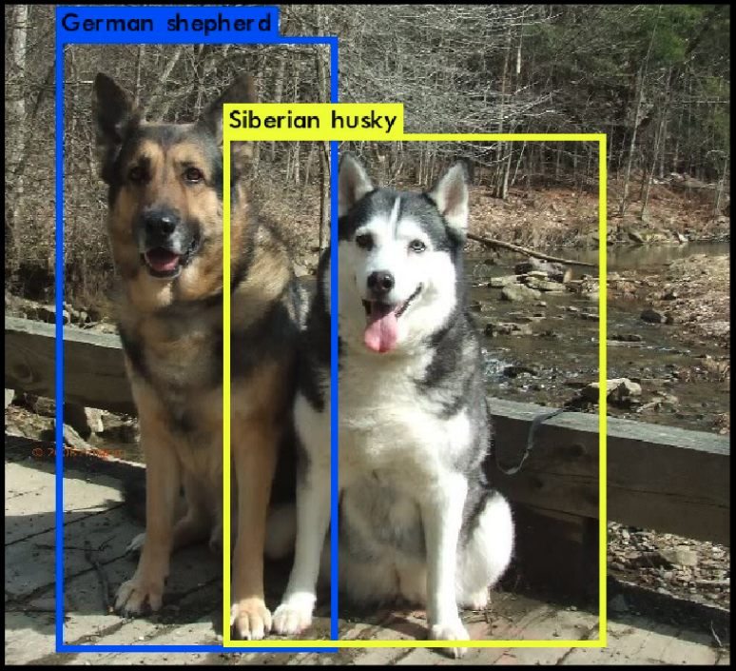
YOLO v2 - more specific classifications

Slide 18
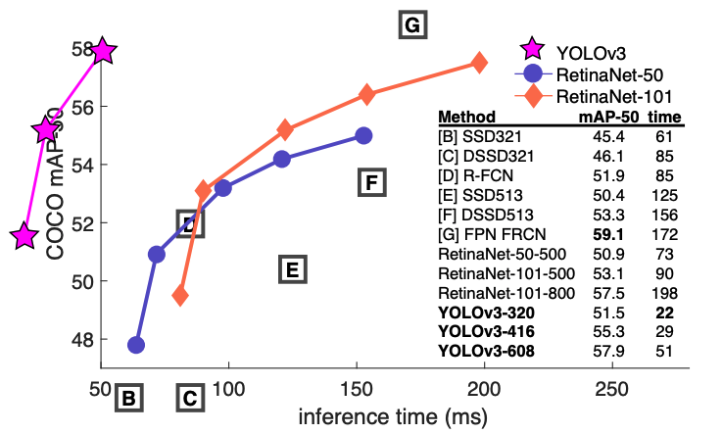
YOLO v3
“... nothing super interesting, just a bunch of small changes that make it better”
E.g better bounding box prediction, tweak an hyperparameter for class prediction etc.
New model, Darknet-53

Slide 19
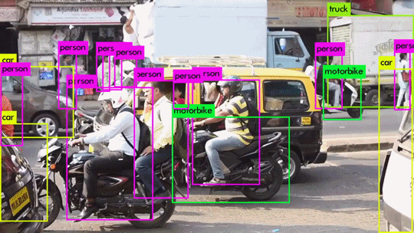
YOLO v3 in action

